Slide 1
Tax Practitioners’ Association, Indore
नव कर मंथन-भाग 2
Charge of Tax, Scope of Income and Residential Status
30/01/2026

Slide 2
Tabular Comparison of Sections
Income-tax Act, 2025 (“ITA 2025”) | Income-tax Act, 1961 (“ITA 1961”) | Particulars
Section 3 | Section 3 | Definition of tax year
Section 4 | Section 4 | Charge of income-tax
Section 5 | Section 5 | Scope of total income
Section 6 | Section 6 | Residence in India
Section 7 | Section 7 and Section 8 | Income deemed to be received and dividend deemed to be income in a tax year
Section 8 | Section 9B | Income on receipt of capital asset/stock-in-trade by specified person from specified entity
Section 9 | Section 9 and Section 9A | Income deemed to accrue or arise in India; Certain activities not to constitute business connection in India
Section 10 | Section 5A | Apportionment of income between spouses governed by Portuguese Civil Code

Slide 3
Section 3 ITA 2025 Vs. Section 3 ITA 1961-
Tax year/Previous year
Theme of Sub-section | Section of ITA 2025 | Section of ITA 1961 | Changes
Tax year refers to period of 12 months of a financial year commencing from 1st day of April | 3(1) | 3 | The definition of year has completely undergone a sea change. Earlier, previous year was to be construed from the definition of assessment year u/s 2(9) of ITA 1961. Asst. year refers to period of 12 months commencing on 1st day of April of every year. In the current definition of tax year, the definition has been made more simplistic by referring the same to be a financial year starting from 1st April of a year. What is Financial year ? It is nowhere defined under the ITA 1961 or the ITA 2025. It is defined u/s 3(21) of General Clauses Act, 1897
Tax year for newly incorporated entities and cases of new source of income- beginning of tax year to be construed from the date of incorporation and date of new source coming into existence, respectively | 3(2) | 3 | No major change except for reference to year

Slide 4
Section 3 ITA 2025 Vs. Section 3 ITA 1961-
Tax year/Previous year
Key issues to consider going forward-
The concept of “previous year” and “assessment year” has been done away with. However, it will still have relevance for ongoing assessments, reassessments, search, seizure, survey, etc. wherein notices, responses, orders shall still be issued and dealt with the concept of assessment year. (Section 536 of ITA 2025 – Savings and Repeal would deal with this issue)
Assessment of income would also be done in context of total income of a tax year.
Financial year and tax year are two different concepts. Financial year is a period of 12 months starting from 1st day of April of a year and ending on 31st day of March of the subsequent year. However, a tax period need not necessarily be of 12 months in cases of newly set up business/profession or new income sources coming into existence after 1st day of April of such year.
Currently, practical difficulties may arise while dealing with the provisions of Black Money (Undisclosed Foreign Income and Assets) and Imposition of Tax Act, 2015 (“BMA”) where still the following concepts remain relevant since no amendments have been brought to the BMA in relation to referencing to ITA 1961-
  Concept of assessment year and previous year
  Return filing under Section 139(1), 139(4) and 139(5) of ITA 1961
  Charging of interest under Section 234A, 234B and 234C of ITA 1961 and more…
  Similarly practical difficulties may arise for ongoing cases under Prohibition of Benami Property Transactions Act, 1988 and Wealth-tax Act, 1957.
  Hopefully, this issue shall be resolved in an upcoming budget.

Slide 5
Section 4 ITA 2025 Vs. Section 4 ITA 1961-
Charge of Income tax
Theme of Sub-section | Section of ITA 2025 | Section of ITA 1961 | Changes
Where any Central Act enacts that Income tax shall be charged on the Total income of the Assessee for such tax year the same would be taxed based upon the rates prescribed, including an additional income tax for the said tax year | 4(1), 4(2) and 4(3) | 4(1) | No major change except for asst. year being replaced by tax year
Income tax shall be charged on income for period other than tax year | 4(4) | Explanation to Section 4 | No change
Income tax on income shall be collected through TDS, TCS and advance tax | 4(5) | 4(2) | Under ITA 1961, the legislators and the tax department missed on explicitly specifying TCS as a mode for tax payment for incomes earned under Section 4(1) of ITA 1961. Therefore, the said change was incorporated under Section 4(5) by adding TCS also as a mode for collection of tax in advance

Slide 6
Section 4 of ITA 2025- Charge of tax
Key issues to consider going forward-
Earlier, income earned in a previous year was taxable in the assessment year. Similarly, with the enactment of ITA 2025, the position would still remain the same, but the relevance of asst. year per se shall be lost.
In the past, the Govt. proposed amendments to the ITA 1961 or any other sister legislation (BMA or Benami) through enactment of Finance Acts. The date of application of the amendments was to be construed from the Finance Act. The Finance Act always states the date on which the amendment is to come into force. The said date referred to the date of the assessment year and not the previous year. Therefore, most amendments implemented vide Finance Acts were to be construed from an assessment year perspective.
However, there were still certain amendments which did not commence from the beginning of an assessment year, but were implemented from the middle of a previous year. For e.g. the implementation of Section 194Q of ITA 1961 was from 01/07/2021 i.e. from previous year 2021-22 (vide Finance Act, 2021) and implementation of Section 206C(1H) of ITA 1961 was from 01/10/2020 i.e. from previous year 2020-21 (vide Finance Act, 2020).
By replacement of previous year and assessment year with tax year, the applicability of proposed amendments in the upcoming budget proposals (pertaining to ITA 2025) shall be construed to be effective from tax year itself. For e.g. if it is stated that an amendment is proposed to be effective from 01/04/2029, then it would be construed to be effective for tax year 2029-30. However, if an amendment is proposed to be effective from 01/10/2029, then it would be construed to be effective from such date itself, relevant to the tax year.
By the introduction of tax year, the charge of tax on income and its applicability has been made easy for understanding. However, the upcoming budget proposal shall provide a greater clarity about it.

Slide 7
Summary for taxation u/s 5 of ITA 2025 and 5 of ITA 1961- Scope of Total Income
Residential Status | Received/Deemed to be received in India | Accrues/Arises or Deemed to accrue/arise in India | Received/Deemed to be received outside India | Accrues/Arises or Deemed to accrue/arise outside India
ROR | Taxable | Taxable | Taxable | Taxable
RNOR | Taxable | Taxable | Not Taxable | Taxable only if business/profession is controlled from India
NR | Taxable | Taxable | Not taxable | Not taxable
Note: Based upon the above principle of taxation, if the Income of an Assessee is getting taxed in two different countries leading to double taxation, then he/she may take a foreign tax credit (after filing appropriate form – Form 67 under Income-tax Rules, 1962) on the said transaction.

Slide 8
Section 5 ITA 2025 Vs. Section 5 ITA 1961-
Scope of Total Income
Theme of Sub-section | Section of ITA 2025 | Section of ITA 1961 | Changes
Total income of a resident (“ROR”)includes income which is received/deemed to be received in India | 5(1)(a) | 5(1)(a) | No major change except for reference to year
Total income of a ROR includes income which accrues/arises in India or deemed to be accure or arise in India | 5(1)(b) | 5(1)(b) | No major change except for reference to year
Total income of a ROR includes income which accrues/arises outside India | 5(1)(c) | 5(1)(c) | No change
Total income of a resident but not ordinarily resident (“RNOR”)includes income accrues/arises outside India of a business or profession, but controlled from India | 5(1)(c) | 5(1)(c) | No change

Slide 9
Section 5 ITA 2025 Vs. Section 5 ITA 1961-
Scope of Total Income
Theme of Sub-section | Section of ITA 2025 | Section of ITA 1961 | Changes
Total income of a non-resident (“NR”)includes income which is received/deemed to be received in India | 5(2)(a) | 5(2)(a) | No change
Total income of a NR includes income which accrues/arises in India or deemed to be accure or arise in India | 5(2)(b) | 5(2)(b) | No change
Income of RNOR and NR accruing/arising outside India shall not be deemed to be received in India merely by virtue of the fact that the same has been accounted in the Indian balance sheet of such person | 5(3) | Explanation 1 | No change
No double counting of the same Income in the Total Income of an Assessee – If already included as income on an accrual basis, the same is not to be included again on receipt basis | 5(4) | Explanation 2 | No change

Slide 10
Section 5 of ITA 2025 and 5 of ITA 1961
Key issues to consider-
Schedule FA must be properly filed by ROR with regards to foreign assets and foreign incomes. It must also be checked that exchange rates as prescribed under Rule 115 of Income-tax Rules, 1962 are used for calculating foreign sourced incomes.
ROR earning foreign incomes and owing foreign assets (foreign depository and custodian accounts, foreign investments, foreign immovable property, etc. or being signatory in foreign bank accounts should also take into consideration the aspects of the BMA. Any non-disclosure or wrong disclosure invites harsh penalties under Section 41, 42 and 43 of the BMA.
It is interesting to note that BMA recognizes only returns filed under 139(1), 139(4) and 139(5) of ITA 1961 for compliance under BMA and not updated return u/s 139(8A) of ITA 1961. However no explicit disregard to 139(8A) has been asserted under BMA. Whether this exclusion is deliberate or not is something to be discussed upon. However, 139(8A) per se restricts filing an updated return in case notice under BMA has already been issued. If 139(8A) is recognized under BMA, it would give little breather to assesses where omission with regards to the disclosure of foreign assets and foreign incomes was bonafide and genuine.
BMA is a draconian law where both assessment proceedings and prosecution proceedings can simultaneously be initiated. Non-compliance of prosecution proceedings u/s 50 and 51 of BMA is a scheduled offence under the Prevention of Money Laundering Act, 1999 having serious ramifications.
Returning Indians such as NR and RNOR must make disclosures of their foreign assets and foreign incomes in the year in which they become ROR in India. Otherwise, even they would have to undergo harsh provisions of the BMA as discussed above.

Slide 11
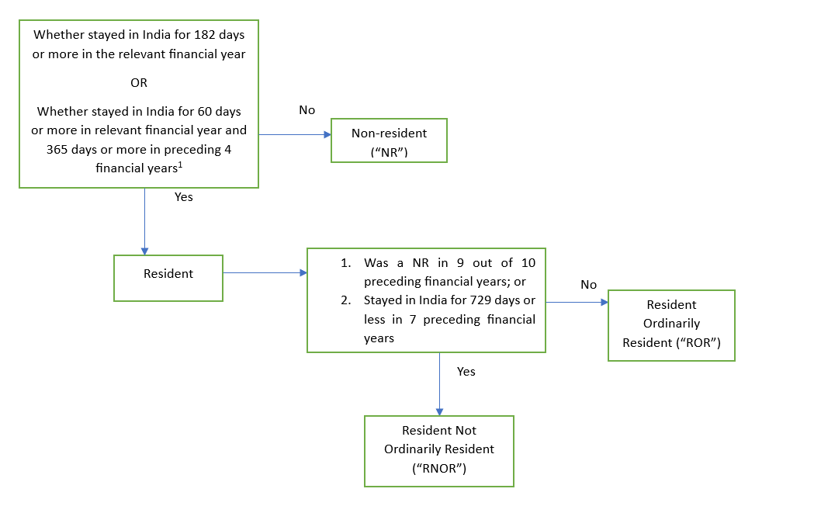
Determination of Residential Status under Section 6 of ITA 2025 and Section 6 of ITA 1961- A brief summary
The limit of 60 days/365 days is not applicable to the following persons-
  Individual who is a citizen of India and leaves India in the current year for the purposes of employment outside India;
  Individual who is an Indian citizen and leaves India in the current year a part of crew of an Indian ship
  Individual who is an Indian citizen or person of Indian origin who is on a visit to India, but lives outside India (here, limit of 120/365 days would be applicable)

Slide 12
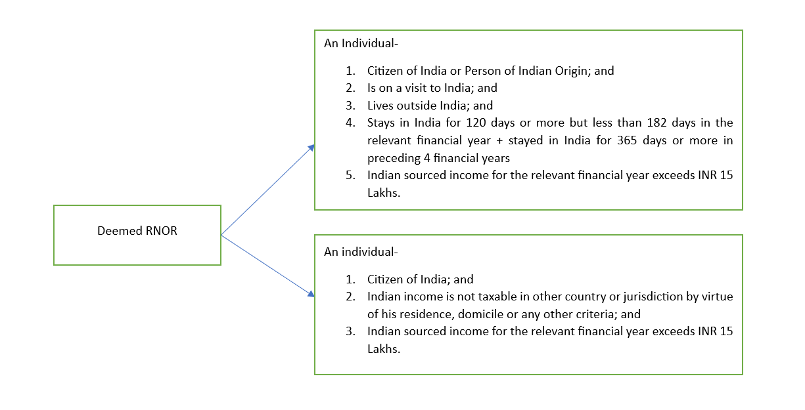
Determination of Residential Status under Section 6 of ITA 2025 and Section 6 of ITA 1961- Concept of Deemed RNOR
Concept of Deemed RNOR introduced via Finance Act, 2020 with two objectives-
NRs intending to visit India as a casual visit; and
NRs residing in tax havens and enjoying benefit of no taxation in the country of which they are a tax resident OR when they don’t become tax residents of any country/jurisdiction, eventually not making them pay tax in any country

Slide 13
Section 6 ITA 2025 Vs. Section 6 ITA 1961- Residence in India
Theme of Sub-section | Section of ITA 2025 | Section of ITA 1961 | Changes
Individual to be a resident in India if stay is 182 days or more in a financial year | 6(2)(a) | 6(1)(a) | No change
Individual to be a resident in India if stay is- (a.) 60 days or more in a financial year; and (b.) 365 days or more in preceding 4 financial years | 6(2)(b) | 6(1)(c) | No change
Criteria for 60 days and 365 days not to apply to citizen of India (Indian passport-holder) who has left India in that financial year for- (a.) Employment outside India; or (b.) As a crew member of an Indian ship defined under Section 3(8) Merchant Shipping Act, 1958 | 6(3) | Explanation 1(a) to Section 6(1) | No change
Calculation of total no. of days in India in respect of that voyage for an Indian citizen who is a member of foreign bound ship leaving India shall be calculated in the prescribed manner | 6(6) | Explanation 2 to Section 6(1) | No change

Slide 14
Section 6 ITA 2025 Vs. Section 6 ITA 1961- Residence in India
Theme of Sub-section | Section of ITA 2025 | Section of ITA 1961 | Changes
Determination of Resident Ordinarily Resident (“ROR”) and Resident Not Ordinarily Resident (“RNOR”)- An individual would be considered a RNOR if any of the following conditions get fulfilled- (a.) Individual was NR in India in atleast 9 financial years out of the 10 preceding financial years; or (b.) Individual stayed in India less than or equal to 729 days in the preceding 7 financial years | 6(2)(a) | 6(1)(a) | No change
If a person is ROR for any of his source of Income, he would be considered a ROR for all his other sources of income as well | 6(12) | 6(5) | No change
Deemed RNOR if all the following conditions are fulfilled- (a.) an Individual is a citizen of India; (b.) such Individual’s income is not liable to tax anywhere in the world by virtue of his residence, domicile or any other criteria; (c.) Indian sourced Income of such individual exceeds INR 15 Lakhs for the said financial year | 6(7) and 6(13)(c) | 6(1A) and 6(6)(d) | No change
If an individual is already a resident under Section 6(2) to 6(6) of ITA 2025, then Section 6(7) of ITA 2025 shall not be applicable. As a result, Section 6(13)(c) of ITA 2025 shall also not trigger. | 6(8) | Explanation to 6(1A) | No change

Slide 15
Section 6 ITA 2025 Vs. Section 6 ITA 1961- Residence in India
Theme of Sub-section | Section of ITA 2025 | Section of ITA 1961 | Changes
For calculation of residential status of “certain individuals”, the limit of 60 days in current financial year and 365 days in preceding financial year (60/365) under 6(2)(b) shall be replaced with 120 days in current financial year and 365 days in preceding financial year (120/365) if Indian sourced Income of such individual exceeds INR 15 Lakhs for the said financial year. Individual here refers to person who fulfills all the following conditions- (a.) is citizen of India/person of Indian origin (Individual or such individual’s either parent(s) or grandparent(s) was born in undivided India) (b.) stays outside India (c.) who is on a visit to India during the said financial year | 6(4) and 6(5) | Explanation 1(b) to Section 6(1)(c) | No change
Deemed RNOR if all the following conditions are fulfilled- (a.) person of Indian origin/citizen of India who stays outside India, but is on a visit to India; (b.) Indian sourced income is more then INR 15 Lakhs for the said financial year; (c.) who has been in India for 120 days or more but not more than 182 days in the said financial year | 6(13)(b) | 6(6)(c) | No change

Slide 16
Section 6 ITA 2025 Vs. Section 6 ITA 1961- Residence in India
Theme of Sub-section | Section of ITA 2025 | Section of ITA 1961 | Changes
A HUF shall be resident in India in a financial year unless its control and management is situated wholly outside India during such year | 6(9) | 6(2) | No change
A company shall be a resident in India in a financial year if- (a.) It is Indian Company (incorporated under Indian laws); or (b.) Its place of effective management (“POEM”) is in India for that financial year | 6(10)(a) | 6(3) | No change
What is POEM ? A place where key management and commercial decisions of the Company are made. Refer CIRCULAR NO.6 OF 2017 [F.NO.142/11/2015-TPL], DATED 24-1-2017 for detailed guidelines. | 6(10)(b) | Explanation to Section 6(3) | No change
Residuary provision – Every person shall be deemed to be resident except if the control and management of his affairs is wholly situated outside India | 6(11) | 6(4) | No change
Definition of Indian Sourced Income – Income other than foreign sourced income Foreign sourced income- Income accruing or arising outside India or which is not deemed to accrue or arise in India. However, any business or profession controlled from India shall be excluded from this definition. | 6(14) | Explanation to Section 6 | No change

Slide 17
Section 6 ITA 2025 Vs. Section 6 ITA 1961- Residence in India
Key issues to consider going forward-
The word “leaving India for the purposes of employment outside India” shall include self-employment/business as well. This has been confirmed by the Mumbai ITAT in case of ACIT Vs. M/s Shri Nishant Kanodia (ITA no.2155/Mum./2023), Kerala High Court in case of CIT v/s O. Abdul Razak, [2011] 337 ITR 350 (Ker.) and vide Circular no.346 dated 30/06/1982.
What does “leaving India for the purposes of employment” mean ? – It construes that whether an individual has received employment abroad or whether he is leaving India in the search of employment abroad, he would still be eligible to take the benefit of the extended time line of 182 days.
Unlike the determination of residential status under Section 2(v) and 2(w) of the Foreign Exchange Management Act, 1999, employment letter or employment visa or any other concrete document substantiating intention to work outside India does not affect the Assessee from taking the benefit of this extended time period.
Under the draft Income-tax Bill, 2025, the legislators under Clause 6(3)(b) proposed limit of 60 days/365 days not to be made applicable on “citizen of India leaving India for employment outside India”. The Bill categorically omitted the use of phrase “for the purposes” and was drafted to take into consideration only those individuals who have received employment outside India and possessed documents/information in hand to substantiate the same. However, the said change was not incorporated in the final draft while passing the Bill and the wordings remained the same as what they were under ITA 1961, keeping the legal position as it was earlier.
While construing residential status under the garb of “leaving India for employment outside India”, the benefit of the extended time limit of 182 days can be taken only when the Assessee left India during the current financial year. As a result, an individual u/s Section 6(3)(2025) or under Explanation 1 to 6(1)(1961) coming back to India in a tax year and going back outside India in the same tax year or the subsequent financial years must have become a NR in the financial year preceding to his departure. Therefore, one will have to plan their visits accordingly and ensure that their stay does not exceed 181 days in the preceding financial years.

Slide 18
Section 6 ITA 2025 Vs. Section 6 ITA 1961- Residence in India
The Bengaluru ITAT in its recent ruling in case of Binny Bansal Vs. DCIT (IT(IT)A NO. 571 (BANG) OF 2023) discussed certain key considerations while determining residential status of a person. The speciality of the said decision was that it was more an intention-based exercise carried out by the Hon’ble ITAT and considering “substance over form” as the supreme decision-making authority while deciding the case in context of the current jurisprudence. The key issues discussed and affirmed by the Hon’ble ITAT in the said decision are-
    The phrase “Person of India origin/Citizen of India being outside India” under Explanation 1(b) of Section 6(1)(c) of ITA 1961 shall be available as a benefit for the extended period of 182 days to only those individuals who were non-residents and intending to visit India for supervising and controlling their investments here in India, meet their family members or visit India on a casual trip. Therefore, one needs to demonstrate their principal economic affairs to vitally vest outside India as well as their stay pattern and family adds a key distinction for determining their interest in India. The Tribunal held that the Assesssee relocated to Singapore recently, however he spent a significant amount of time in India reflecting that he was not a “casual visit” to India.
    The Tribunal also observed that the benefit of 182 days criteria to individuals leaving India for employment purpose is available only for the financial year in which the Assessee leaves India, and not the subsequent years. Therefore, if a person is residing outside India for the purpose of employment, he shall still be liable to assess his residential status using both the limbs i.e. (i) 182 days criteria and (ii) 60/365 days criteria.

Slide 19
Section 6 ITA 2025 Vs. Section 6 ITA 1961- Residence in India
    The tie-breaker test under the tax treaties acts as an important tool for deciding tax residency in cases where a person becomes a tax resident of more than 1 tax jurisdiction. In the current case-
      the ITAT could not determine the residential status of the Assessee based upon the permanent home available to him, given the fact that the Assessee had taken on lease a residential premise for long-term basis in Singapore and also owned residential premises in India.
      The ITAT ruled that the although the Assessee was on a payroll or under the employment of a foreign company in Singapore, still his major investments continue to be in India. Further to this, he is also one of the most successful entrepreneurs from India and continues to invest in India. In fact, even though the Tribunal did not explicitly mention in its judgement, the AO pointed out that the Assessee sold shares of foreign companies deriving its value from an Indian company, further signifying his economic interest in Indian businesses. The Tribunal found out that the economic interest of the Assessee was closer to India when compared to Singapore.
      The Assessee being an Indian national, the Tribunal held that since the vital economic interests being in India and he himself being an Indian would be considered to be a tax resident of India
    All in all, this transpires that “intention” is a crucial factor while determining residential status of a person. This is also related to how the Foreign Exchange Management Act, 1999 works while determining residential status of a person. Although there is no change in law related to residential status under the ITA 2025, however recent judicial precedents have charted a different path for analysing the substance of transaction while deciding the tax residency.

Slide 20
Section 6 ITA 2025 Vs. Section 6 ITA 1961- Residence in India
    The Govt. has not prescribed as to how should one calculate the number of days while determining residential status. While the Income tax department has mostly stressed upon including both the date of arrival and date of departure (as stated in the passport) for calculation of the number of days for stay, however there are judicial precedents where the Hon’ble Courts have held that only the date of departure should be considered for stay calculation, owing to Section 9 of General Clauses Act, 1897-
      Samir Kumar Ghosh Vs. ITO Ward 16(4), Kolkata (I.T.A. No. 819/KOL/ 2015)
      ITO 3(4), Kanpur Vs. Shri Sharad Mishra (ITA No.599/LKW/2012) (Special case where Assessee was outside India for 183 days and, in India for not complete 182 days)
      ITO Vs. Dr. R.K. Sharma (IT APPEAL NO. 1230 (JP.) OF 1985) (Special case where Assessee was outside India for 183 days and, in India for not complete 182 days)
      Director of Income-tax, International Taxation, Bangalore Vs. Manoj Kumar Reddy Nare (Kar. HC - IT APPEAL NO. 431 OF 2009 )
      Income Tax Officer (IT)-1(1) Vs. Fausta C. Cordeiro (IT APPEAL NOS. 4933 & 4934 (MUM.) OF 2011)
      Pradeep Kumar Joshi Vs. Income-tax Officer, Ward-1, International Taxation, Ahmedabad (IT APPEAL NO. 452 (AHD.) OF 2020)

Slide 21
Section 7 ITA 2025 Vs. Section 7 and 8 ITA 1961- Income deemed to be received and Dividend Income
Theme of Sub-section | Section of ITA 2025 | Section of ITA 1961 | Changes
Annual accretion in the financial year to the balance at the credit of an employee participating in the RPF deemed to be income in such financial year to the extent provided in the Rules | 7(1)(a) | 7(i) | No change
Transferred balance in a RPF deemed to be income of the financial year in which the same is transferred, to the extent provided in the Rules | 7(1)(b) | 7(ii) | No change
Contribution made by CG/any other employer to the account of the employee under pension scheme u/s 124(2025)/80CCD(1961) deemed to be income of the financial year in which such contribution is made | 7(1)(c) | 7(iii) | No change
Dividend distributed/declared/paid u/s 2(22)(a) to (e) under ITA 1961/ u/s 2(40)(a) to (f) under ITA 2025 to be deemed to be the income of financial year in which it is distributed/declared/paid | 7(2)(a) | 8(a) | Dividend on buyback also covered under ITA 2025
Interim dividend to be the income of such financial year in which it is made unconditionally available to the members who are entitled to it | 7(2)(b) | 8(b) | No change

Slide 22
Section 10 ITA 2025 Vs. Section 5A ITA 1961- Apportionment of income between spouses governed by Portuguese Civil Code
Theme of Sub-section | Section of ITA 2025 | Section of ITA 1961 | Changes
If (i.) a husband and wife are living in Goa, UT of Dadra and Nagar Haveli or UT of Daman and Diu and; (ii) are governed by community of property system under the Portugese Civil Code of 1860, then their income shall not be assessed together with the income of the community | 10(a) | 5A(1) | No change
Total income (other than salary) of both husband and wife shall be divided equally between them and would be offered to tax | 10(b) | 5A(1) | No change
Income from salary of husband and wife shall be separately offered to tax by them in their individual capacities and the same shall not be divided equally | 10(c) | 5A(1) | No change
Spouse who has actually earned the salary shall add such salary to his/her total income | 10(d) | 5A(2) | No change

Slide 23
Thank you.
CA. Chirayu Sodani
M/s Sodani & Co.
Chartered Accountants
Email: sodanichirayu@gmail.com
Contact: +91 9406582326

