Slide 1

Analysis of Indirect Proposals in Union Budget 2026
By CA Krishan Garg M.Com., F.C.A., C.S., DTMP.

Slide 2
CONTENTS
01
Overview of Union Budget 2026
02
Indirect Tax Proposals (GST)
03
Changes in GSTR-3B Returns

Slide 3


PART.
01
Overview of Union Budget 2026

Slide 4
Overview of Budget Proposals
GST & Excise
Customs
GST Amendment in GST provisions to give effect of GST council recommendations and Court Decisions Excise No Major changes
Certain effective rates which were implemented through notifications are now being incorporated in the First Schedule to the Customs Tariff Act ○ New Tariff Lines created ○ Review of existing customs duty exemptions including conditional and unconditional exemptions

Slide 5
PART.
02
Indirect Tax Proposals (GST)

Slide 6

Goods and Services Tax (GST) Changes
Intermediary
Effect
Section 13(8)(b) of the IGST Act has been omitted by Finance Bill 2026 Place of supply for intermediary would be the default provision Section 13(2)
POS- Location of Recipient
A Big relief for intermediaries Earlier they were required to pay GST despite of receiving payment in foreign currency Question- What about past period ??

Slide 7

Post Sale Discount : Section 15(3)(b)
Sec. 15(3)(b)
Post sale discount is allowed to reduce from taxable value of supply if There is an agreement prior to allowing discount and Recipient reversed ITC
Amendment
Now Post sale discount can be granted through a CN u/s 34 No more reference to an agreement CN and reversal of ITC would be sufficient
Linkage to a specific invoice is not needed

Slide 8
Amendment in section 34
01
02
Type here...
Corresponding amendment to Section 34 to facilitate credit note for post supply discounts under Section 15(3)(b).
Effective date
It will be effective from a date to be notified
Type here...
Type here...
Type here...

Slide 9
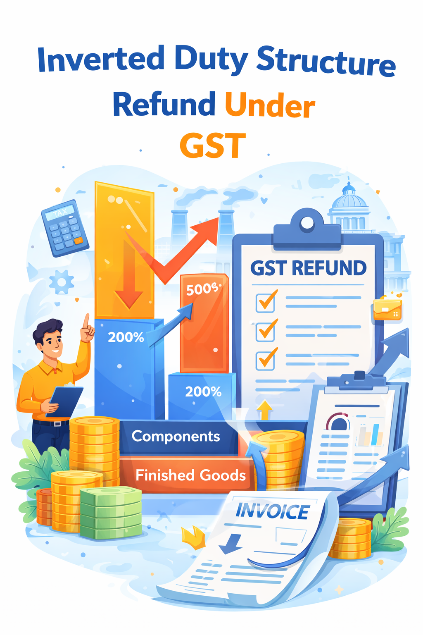
Refunds
Inverted Duty Structure
Refund claimed under Section 54(3)(ii)
Type here...
Provisional Refund 90%
Amendment to Section 54(6) to provide for provisional grant of 90% of the refund claimed subject to conditions
Type here...
Type here...
Type here...

Slide 10
National Appellate Authority for Advance Rulings
Appellate Authority for Advance Ruling (AAAR)
Proposal in FA 2026
Government on the recommendations of the GST Council to empower any existing authority constituted under any law for the time being in force to exercise such function till NAAAR is constituted
Conflict between AAAR Rulings
Type here...
Type here...
Finance Act, 2019
Existing Authority
Type here...
FA (2) 2019 constituted National Appellate Authority for Advance Rulings (NAAAR) in order to hear such conflicts under Section 101A but till the date not implemented
Existing authority shall include a Tribunal
Type here...

Slide 11

Refund
Exports
Amendment to Section 54(14) to remove the threshold limit of Rs 1000
Type here...
Type here...
Type here...
Type here...

Slide 12
PART.
03
Recent Changes in GSTR3B Returns

Slide 13
Changes in GSTR3B effective from Jan-26 Returns
Changes mainly focussing on
Type here...
Type here...
Interest calculation Interest will be calculated after considering Cash Balance. Will show minimum amount to pay. Can be increased but cannot be reduced.
Type here...
Type here...
Type here...

Slide 14
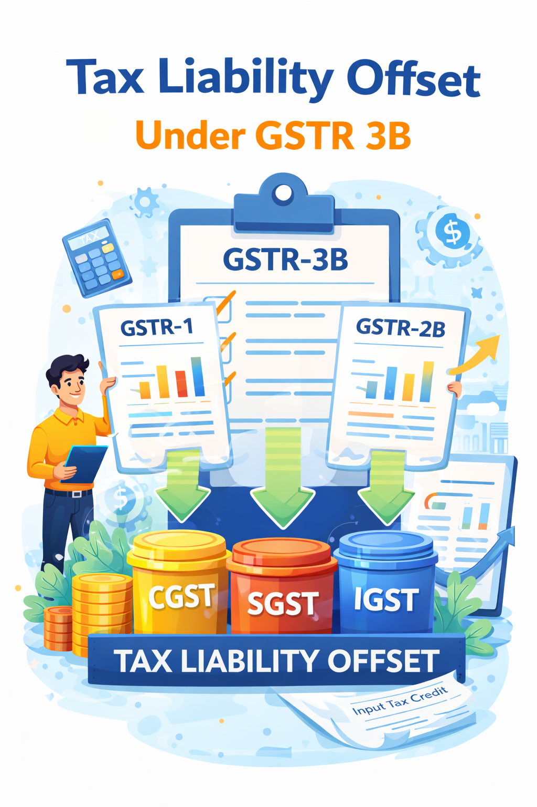
Breakup of tax paid
Invoices of previous months are reported late in GSTR-1 and tax is paid in the current GSTR-3B.
Type here...
GST portal will automatically show a breakup of tax related to earlier periods but paid in the current return.
Type here...
Type here...
Type here...

Slide 15
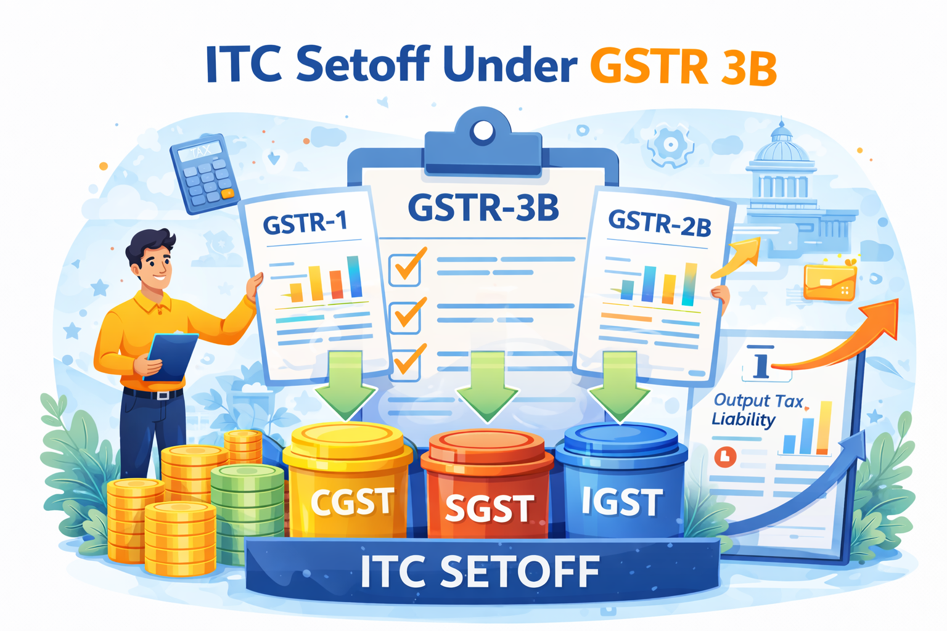
Flexibility in Using ITC
Utilisation of CGST and SGST to pay IGST liability
Once IGST credit is fully used, taxpayers can use CGST and SGST credit
in any order
to pay IGST liability.
Type here...
Type here...
In case of Refund
Type here...
No clarity on utllisation of ITC
Type here...

Slide 16
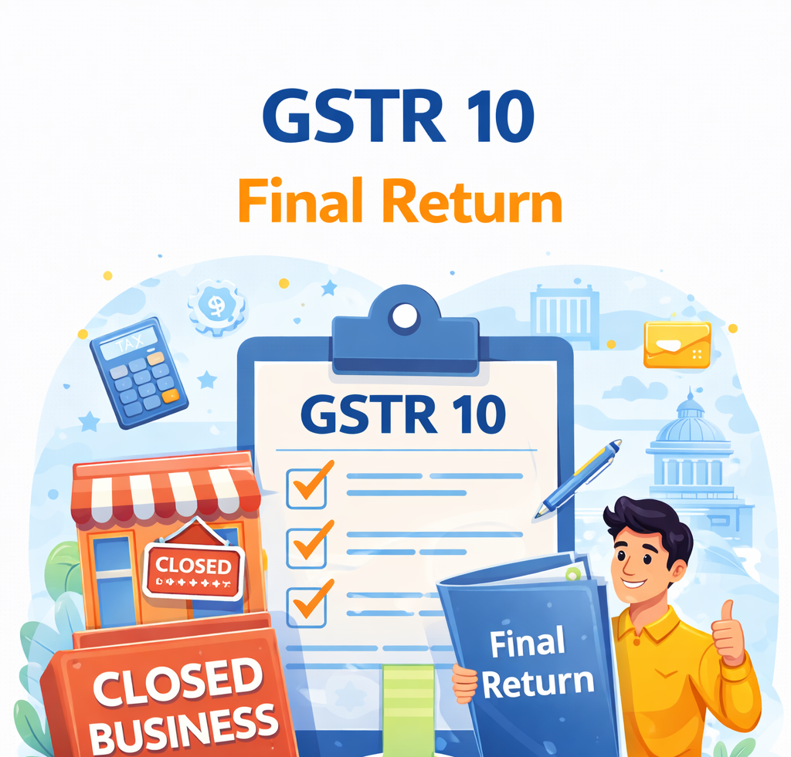
Interest Recovery Through Final Return (GSTR-10)
GST registration is cancelled, any delay in filing the last applicable GSTR-3B will attract interest.
Type here...
Going forward, such interest will be recovered through GSTR-10, the final return. This ensures that interest liability is not left unpaid even after cancellation of registration.
Type here...
Type here...
Type here...

Slide 17
Thank You!
CA Krishan Garg

